Slide 1
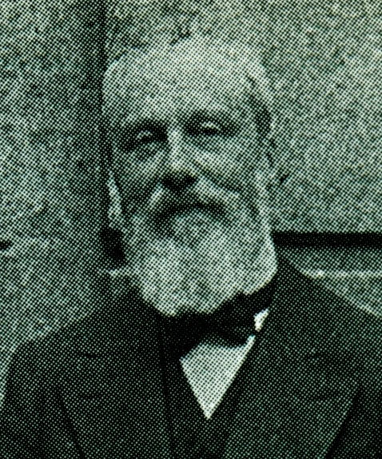
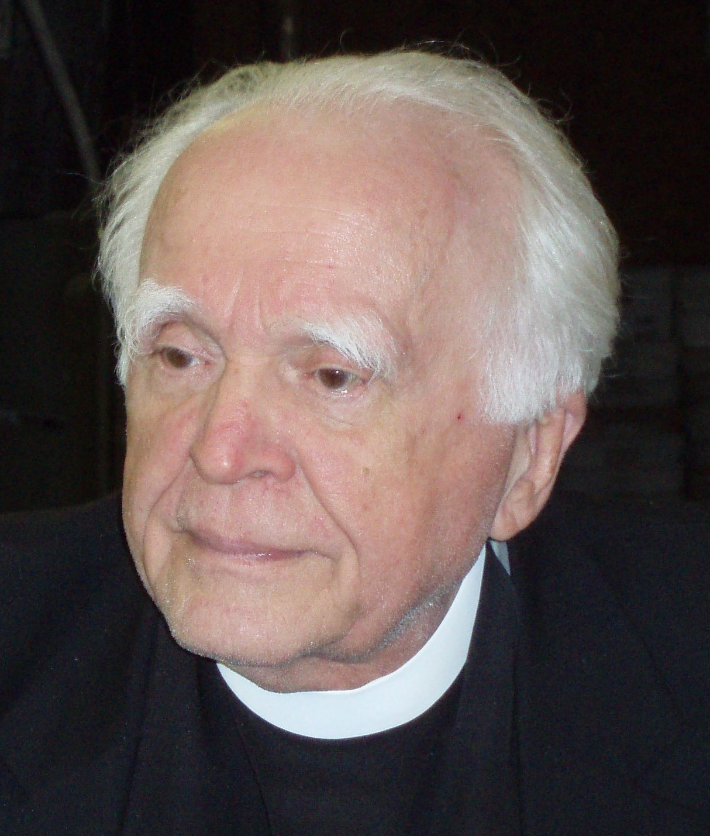
Pierre Duhem,
Stanley Jaki
and the birth of science
On the so called conflict
between science and the Catholic Church

Slide 2
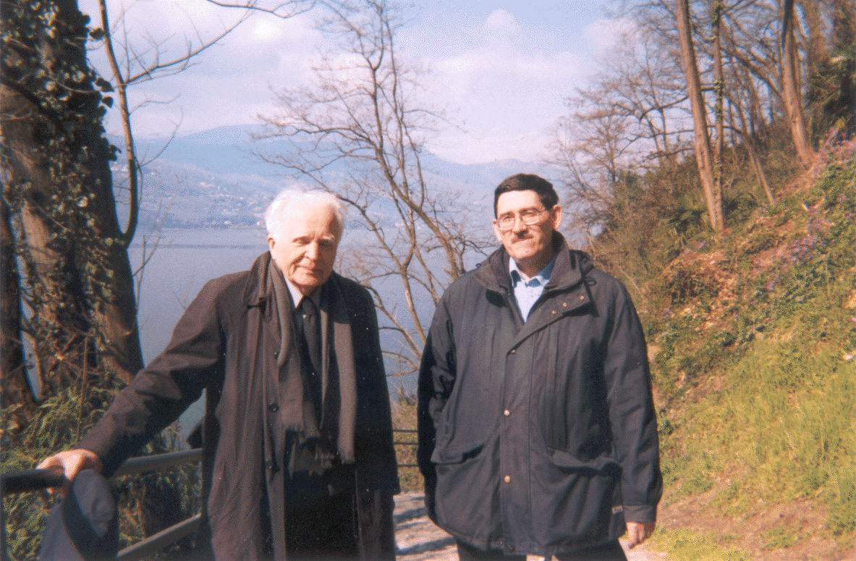
Stanley Jaki
and
Antonio Colombo
Nov. 11, 1999.
In the background
the Lake Maggiore.

Slide 3
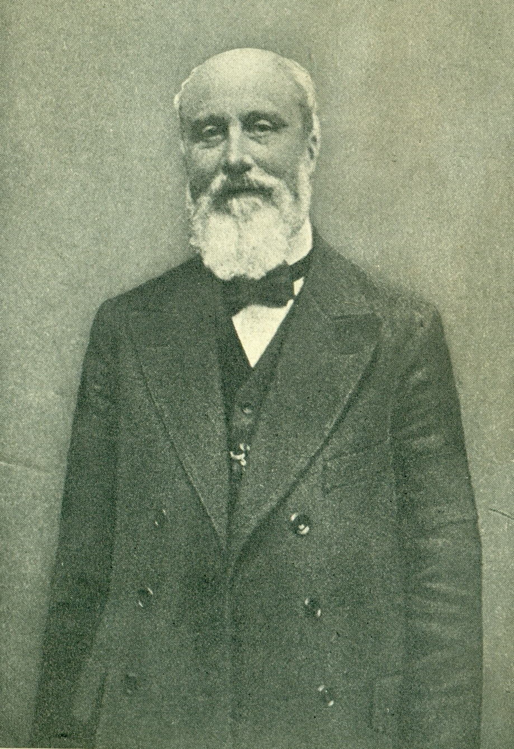
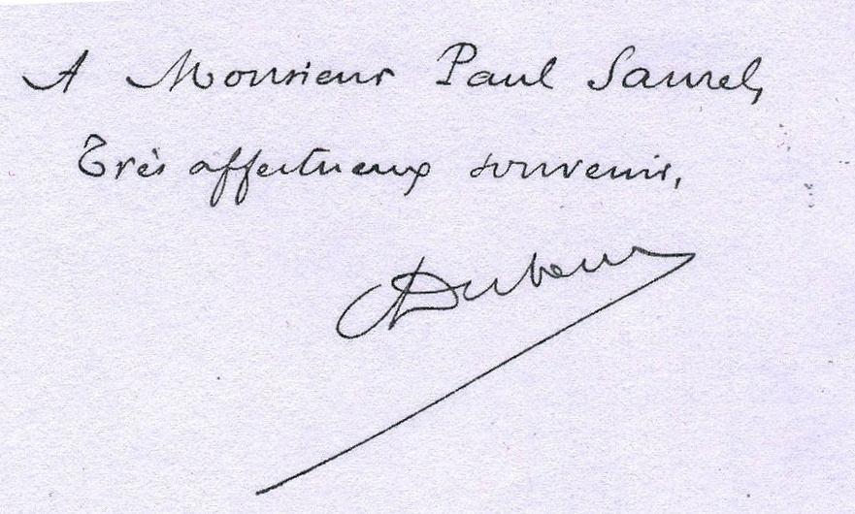
Pierre Maurice Marie Duhem
Paris, 9 June 1861
Cabrespine, 14 September 1916

Slide 4
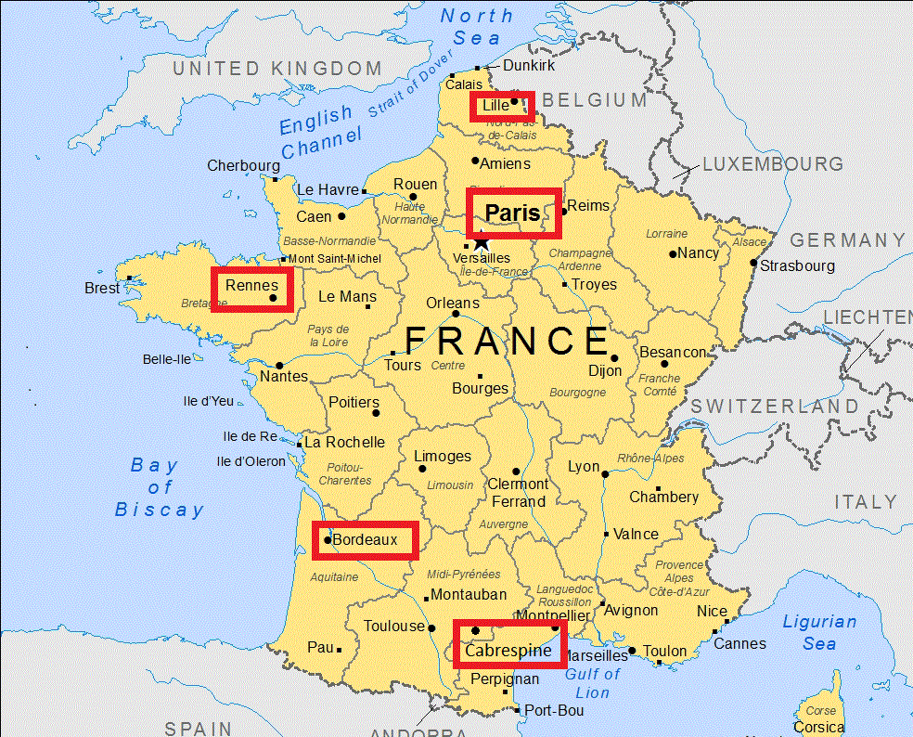

Slide 5
Life
1861 Born in Paris, 9 April
1872 Stanislas College
1882 École Normale (Scientific Section)
1884 Thesis in physics rejected (Berthelot)
1887 Lecturer at the University of Lille
1888 Thesis in Mathematics on the Theory of Magnetism
1890 October, gets married (in Paris) with Adele Chayet
1891 Hélène Duhem born 29 September
1892 Wife's death 28 July
1893 Rennes
1894 Bordeaux (le chemin de Paris)
1895 Professor of Theoretical Physics
1900 Membre Correspondent of the Academy of Sciences of Paris
1916 Death in Cabrespine, 14 September

Slide 6
Main Publications:
(a total of over 550 between essays and books)
* 1883 Au pays des gorilles (satire against Darwinian materialism)
* 1886 Le potentiel thermodynamique et ses applications à la mécanique chimique, et aux phénomènes électriques.
* 1891 Hydrodynamique, Élasticité, Acoustique
* 1891-1892 Leçons su l'électricité et le magnetisme (3 volumes)
* 1893 Introduction à la mécanique chimique
* 1903 L'évolution de la mécanique
* 1906 La théorie physique: son object et sa structure
* 1906-1909 Études sur Leonard de Vinci
* 1908 Sozein ta phainomena (To Save the Phenomena)
* 1911 Traite d'Energetique (2 Volumes)
* 1913-1959 Le système du monde: Histoire des doctrines cosmologiques de Platon a Copernic
* 1915 La science allemande

Slide 7
Duhem the scientist
Duhem's interests fell roughly into periods.
His work in thermodynamics and electromagnetism was predominantly in the period 1884-1900; he returned to the latter between 1913 and 1916.
His interest in the philosophy of science was mostly between 1893 and 1906, and the history of science primarily between 1904 and 1916, although his earliest papers date from 1895.
Finally he concentrated on hydrodynamics and elasticity between 1900 and 1906.
-- Donald G. Miller, Physics today, December 1966

Slide 8
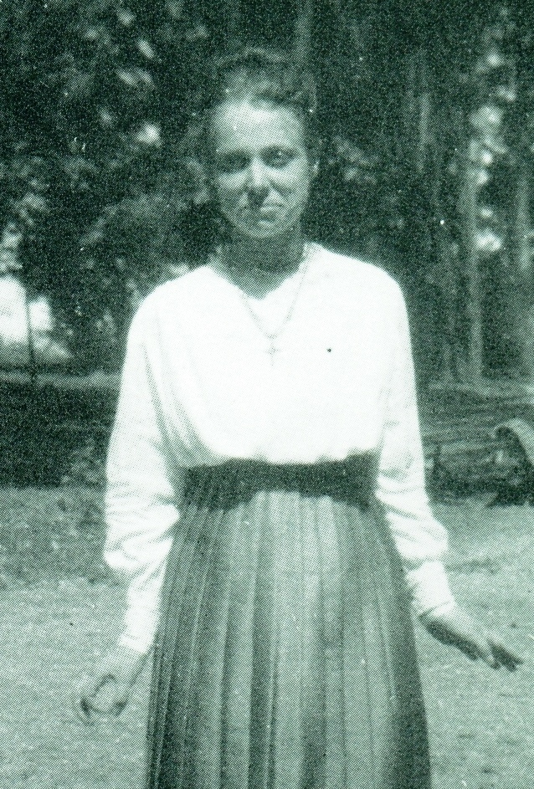
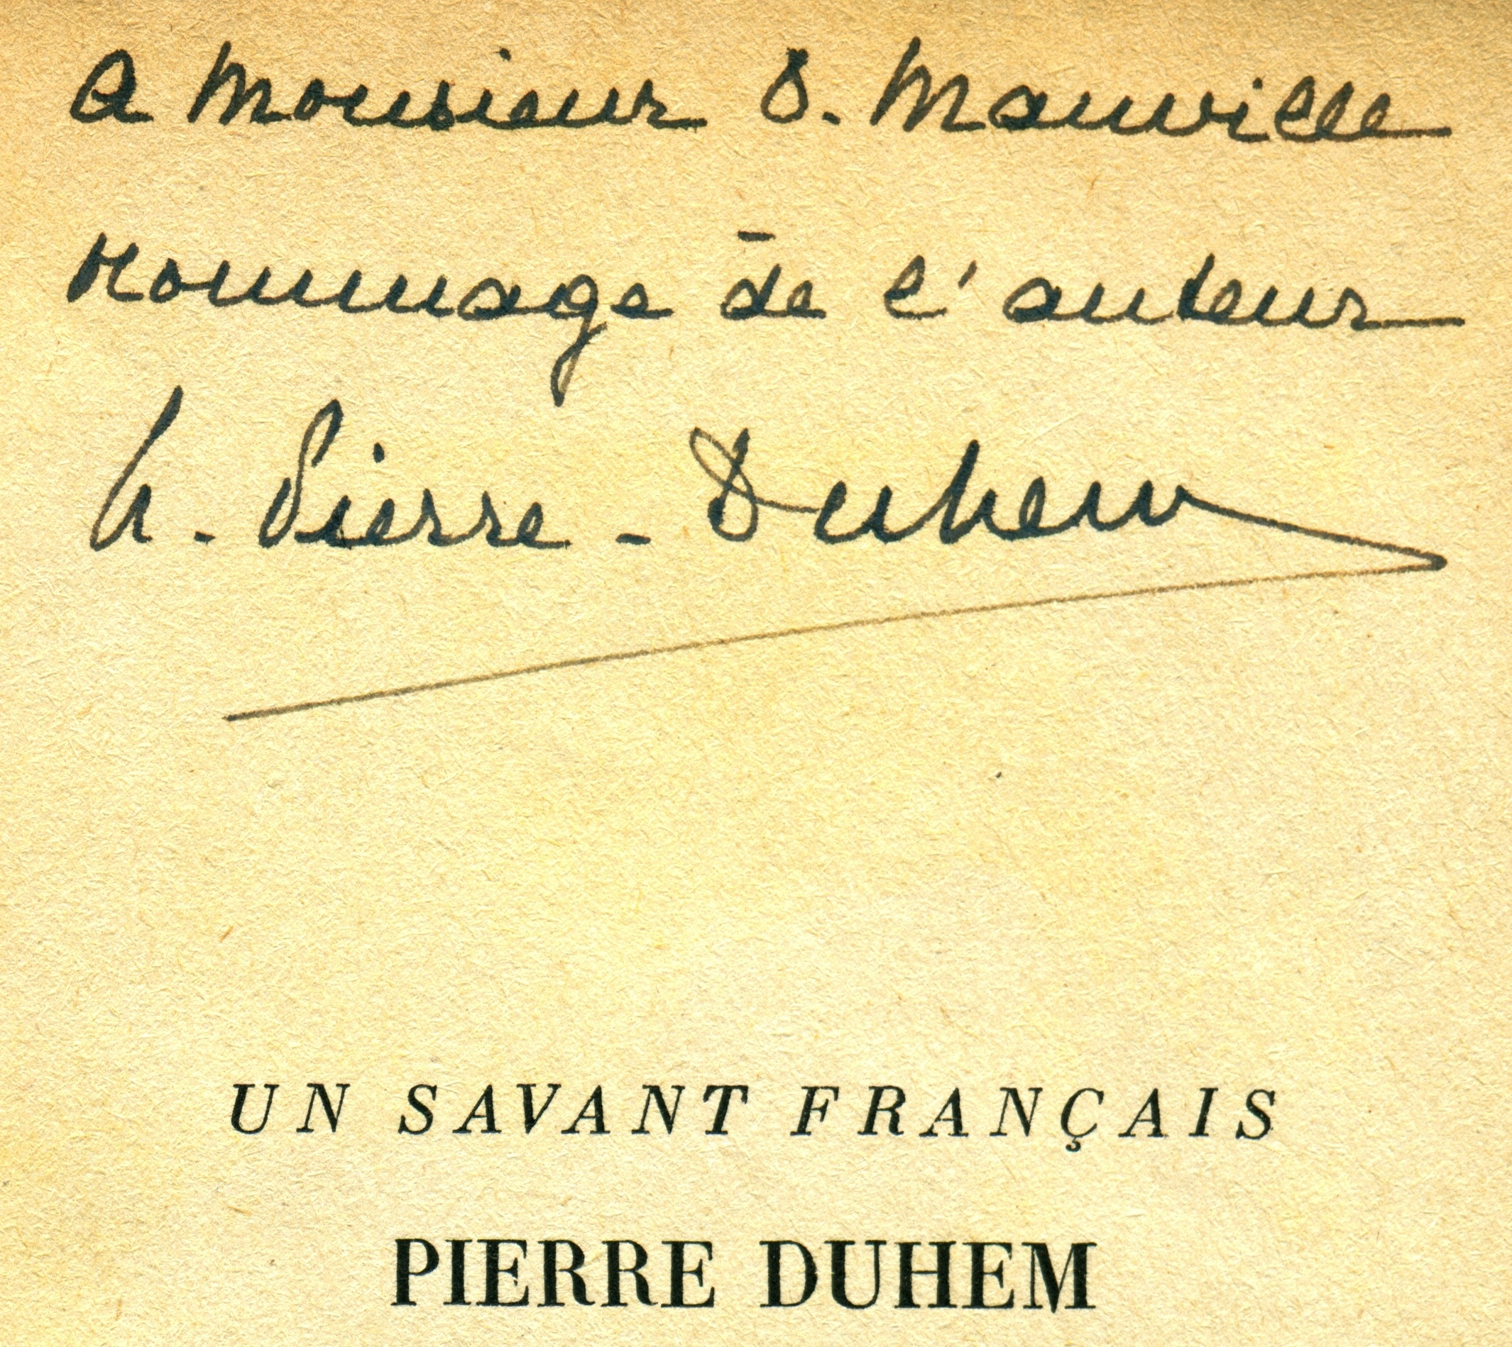
Hélène Pierre-Duhem
Lille, 29 September 1891
Carcassonne, 24 April 1974

Slide 9
Hélène Duhem
1891 Born in Lille, 29 September
1892 Death of her mother
1906 Death of her grandmother
1916 Death of her father
1933 Decides to devote his life to the memory of his father
1936 Un Savant Français: Pierre Duhem
1954-1959 Publication of the last five volumes of Le système du monde, and reprint of other works of Pierre Duhem
1974 Dies in Carcassonne, 24 April

Slide 10
Duhem the historian
Reverence for the historical record
Reliance on original sources (Latin and Greek)
Duhem dealt at first with the History of mechanics
Nothing between Aristotle and Leonardo / Galileo?
Science does not happen in a vacuum:
«The science of mechanics and physics derives in an uninterrupted sequence of hardly visible improvements from doctrines professed in medieval school. The pretended intellectual revolutions were all too often but slow and long-prepared evolutions. The so-called renaissances were often but unjust and sterile reactions. Respect for tradition is an essential condition of scientific progress.»
-- Pierre Duhem, Les origines de la statique, p. 2

Slide 11
Middle Ages and Aristotle
Translation of Aristotles’ works (from XI Century)
Incompatibility of Aristotles doctrine with Christian Revelation
Etienne Tempier (Bishop of Paris) condemns 219 propositions (1277)
«If we were to specify the birthdate of modern science, we should undoubtely choose that year, 1277.»
--Pierre Duhem, Etudes sur Léonard de Vinci, II, 432

Slide 12
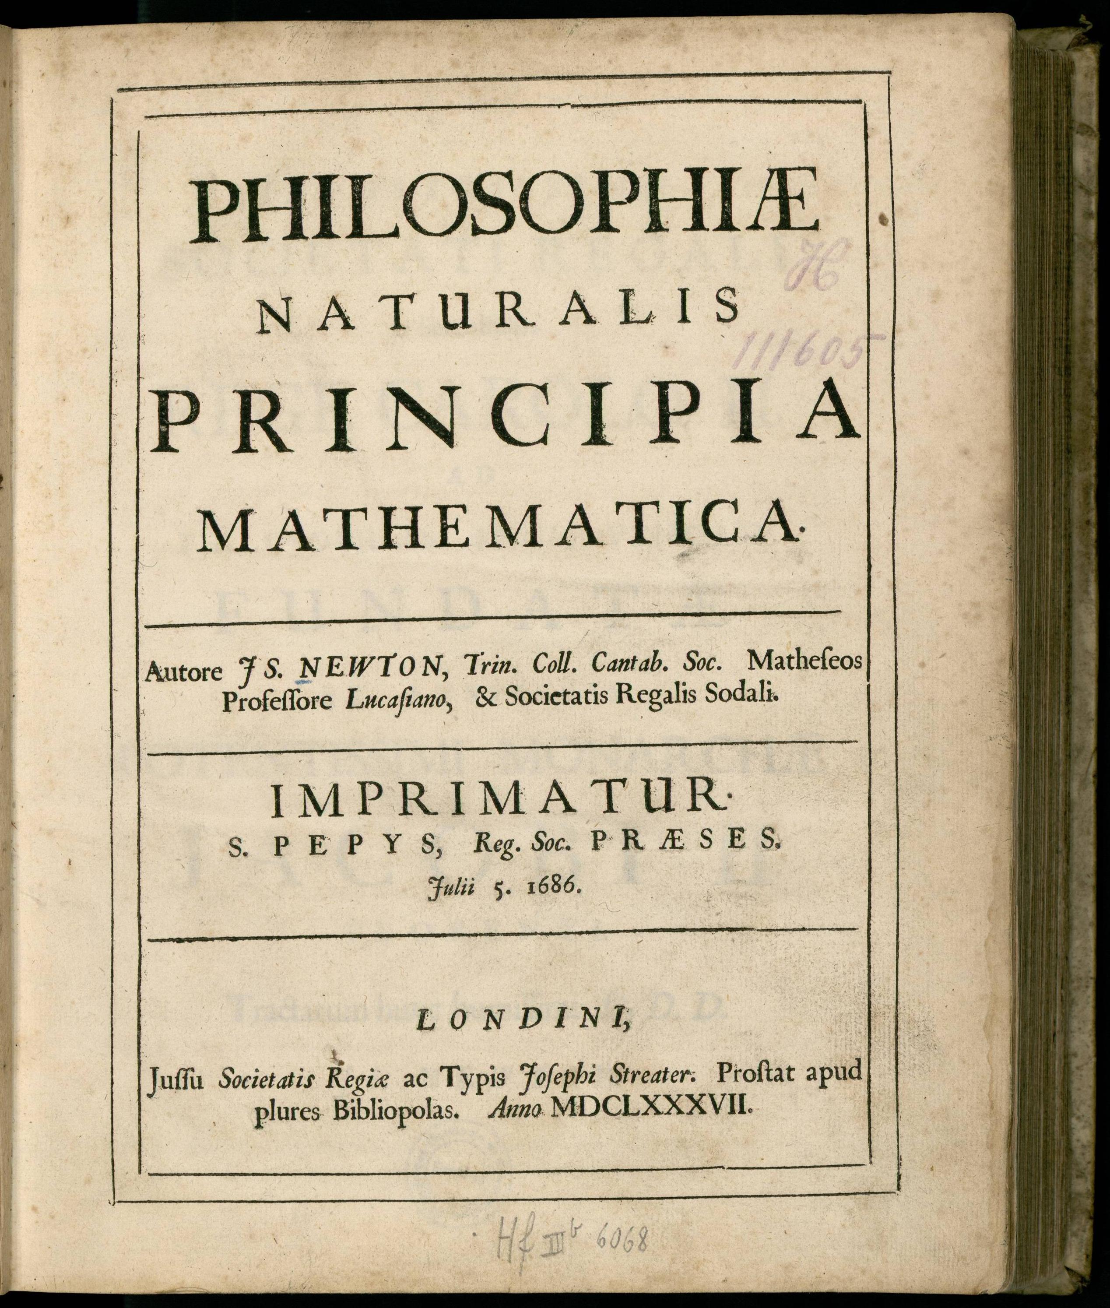
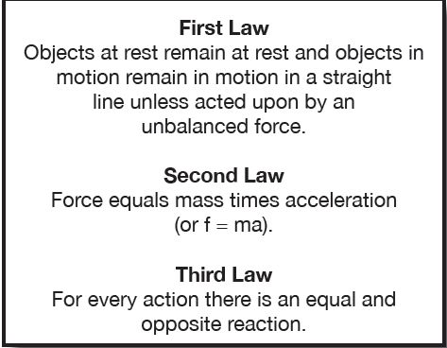
Newton’s Laws of motion

Slide 13
Jean Buridan (circa 1295-1361)
Master of Arts (not a theologian)
Rector of the University of Paris for some time
Introduced the theory of impetus
Commentet works of Aristotle, particularly
De Coelo and Physica
Ioannis Buridani Expositio Et Quaestiones in Aristotelis Physicam Ad Albertum de Saxonia Attributae. Tome III: Quaestiones (Liber IV - Liber VIII)
Copies of his books went to other European universities and were familiar to Copernicus and Descartes

Slide 14
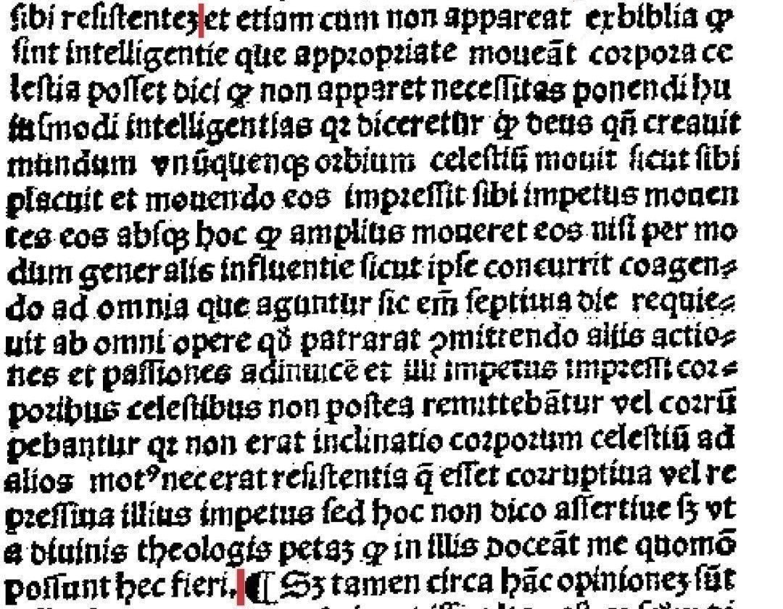

Slide 15
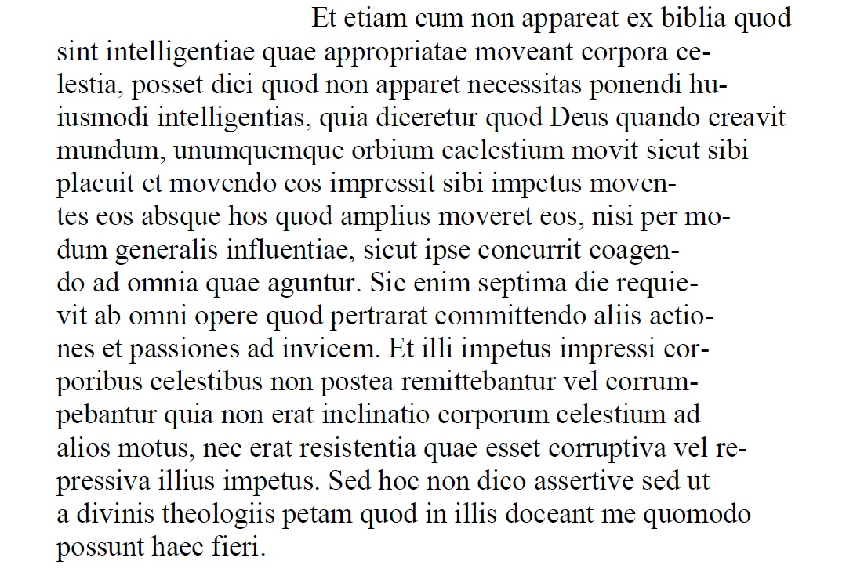

Slide 16
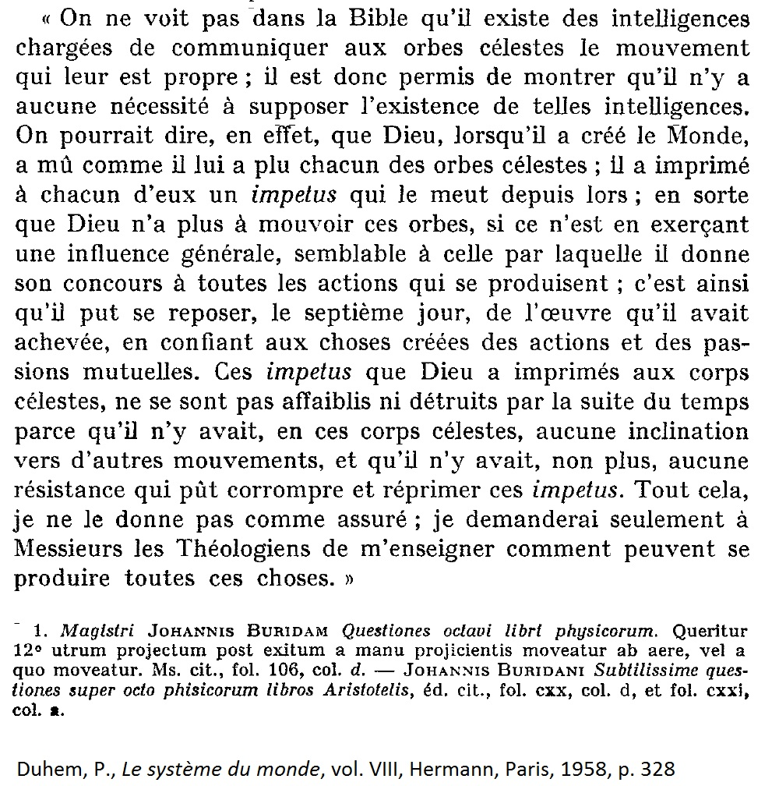

Slide 17
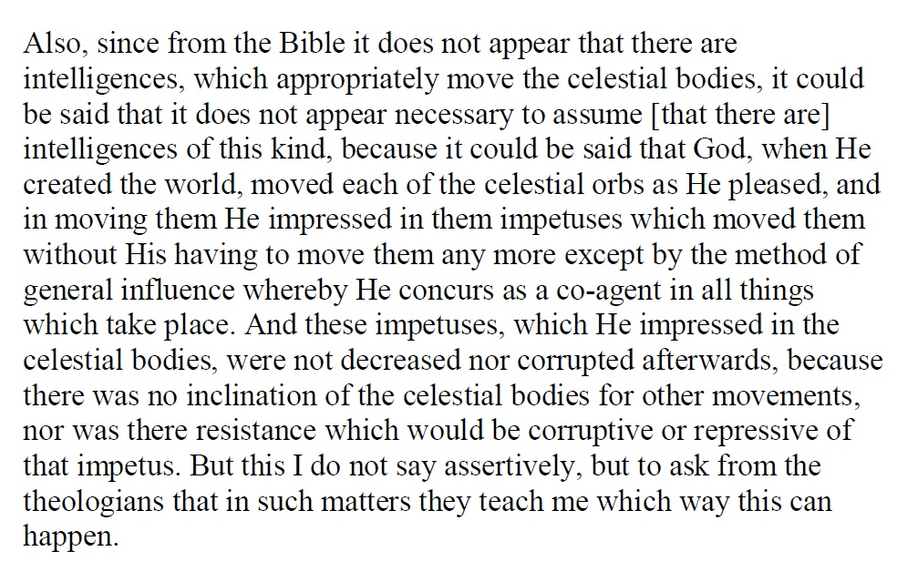

Slide 18
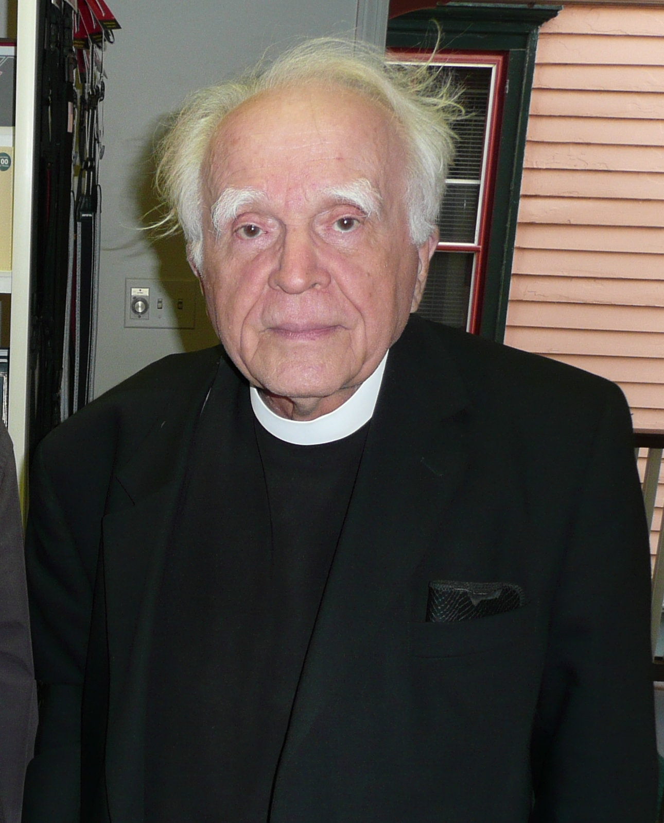
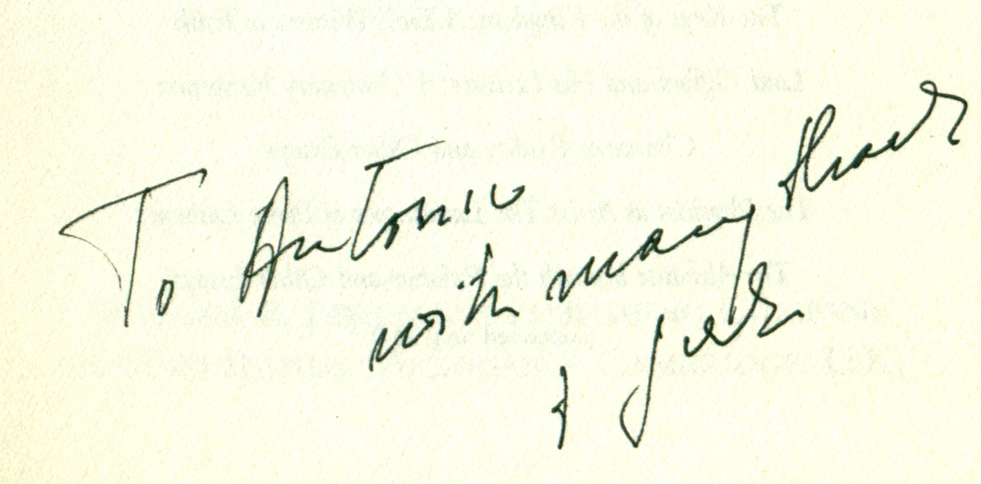
Stanley Ladislas Jaki
Györ (Hungary) 17 August 1924
Madrid (Spain) 7 April 2009

Slide 19
Life and works
(a total of over 700 between essays and books)
1924 Born in Györ (Hungary), 17 August
1942 Enters the Benedictine convent of Pannonhalma
1947 Sent to Rome for completing studies (Sant'Anselmo)
1948 Ordered priest in Assisi
1950 Degree in Theology (Les tendences nouvelles de l'ecclesiologie)
1950 Sent to the United States, as a teacher
1957 Ph.D. in Physics (Fordham)
1966 The Relevance of Physics
1966 Professor at Seton Hall (New Jersey) (Damnatus ad litteras)
1974 Science and Creation
1987 Templeton Prize
1988 The Savior of Science
1990 Member of the Pontifical Academy of Science
1996 Bible and Science
1998 Genesis 1 Through the Ages
2002 A Mind's Matter (Intellectual autobiography)
2009 Dies in Madrid, 7 April

Slide 20
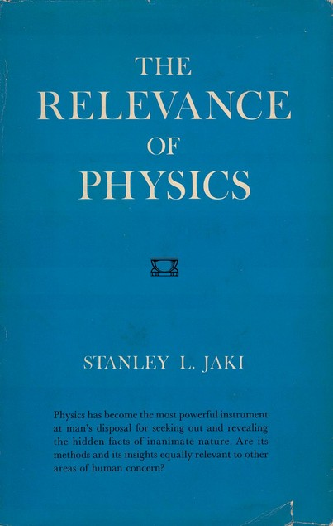
Physics has become the most powerful instrument at man’s disposal for seeking out and revealing the hidden facts of inanimate nature.
Are its methods and its insights equally relevant to other areas of human concern?

Slide 21
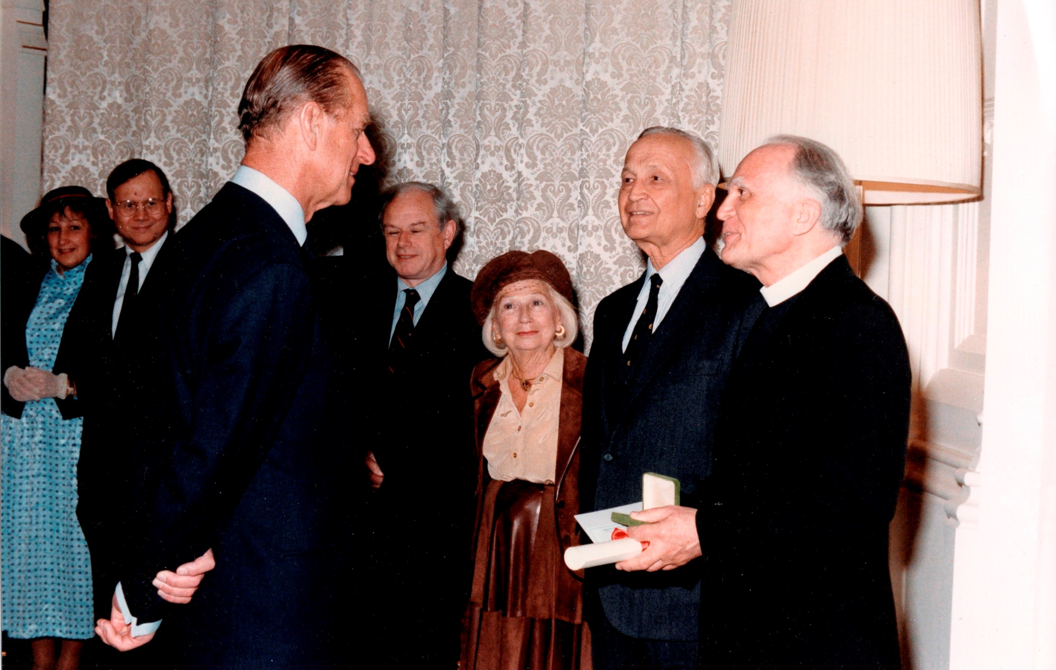
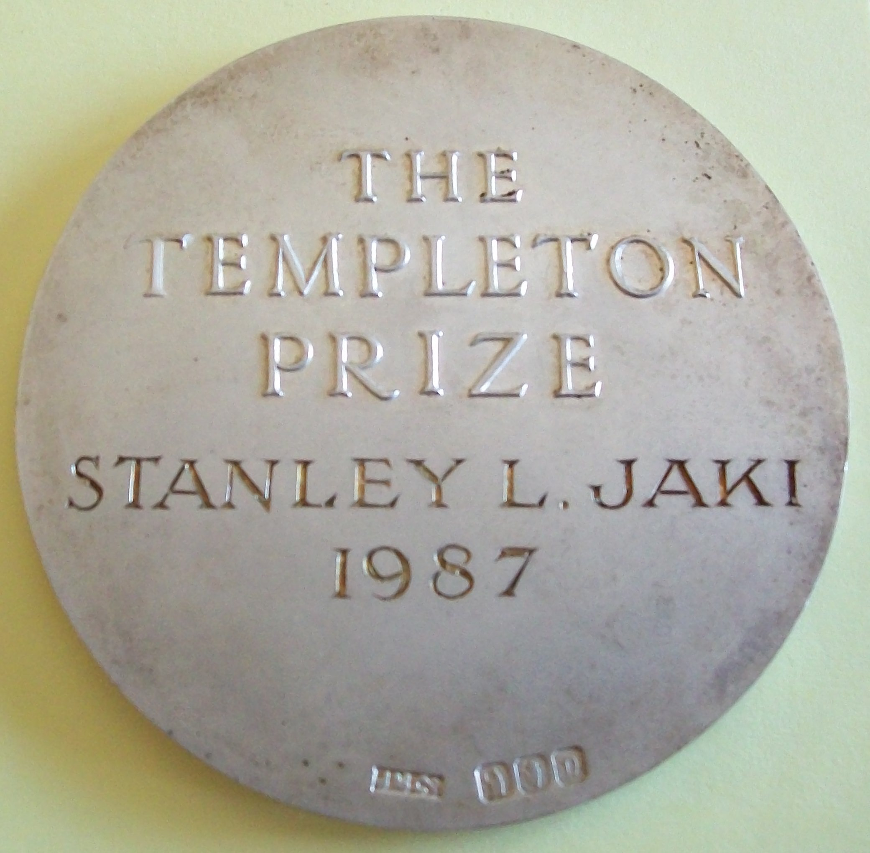
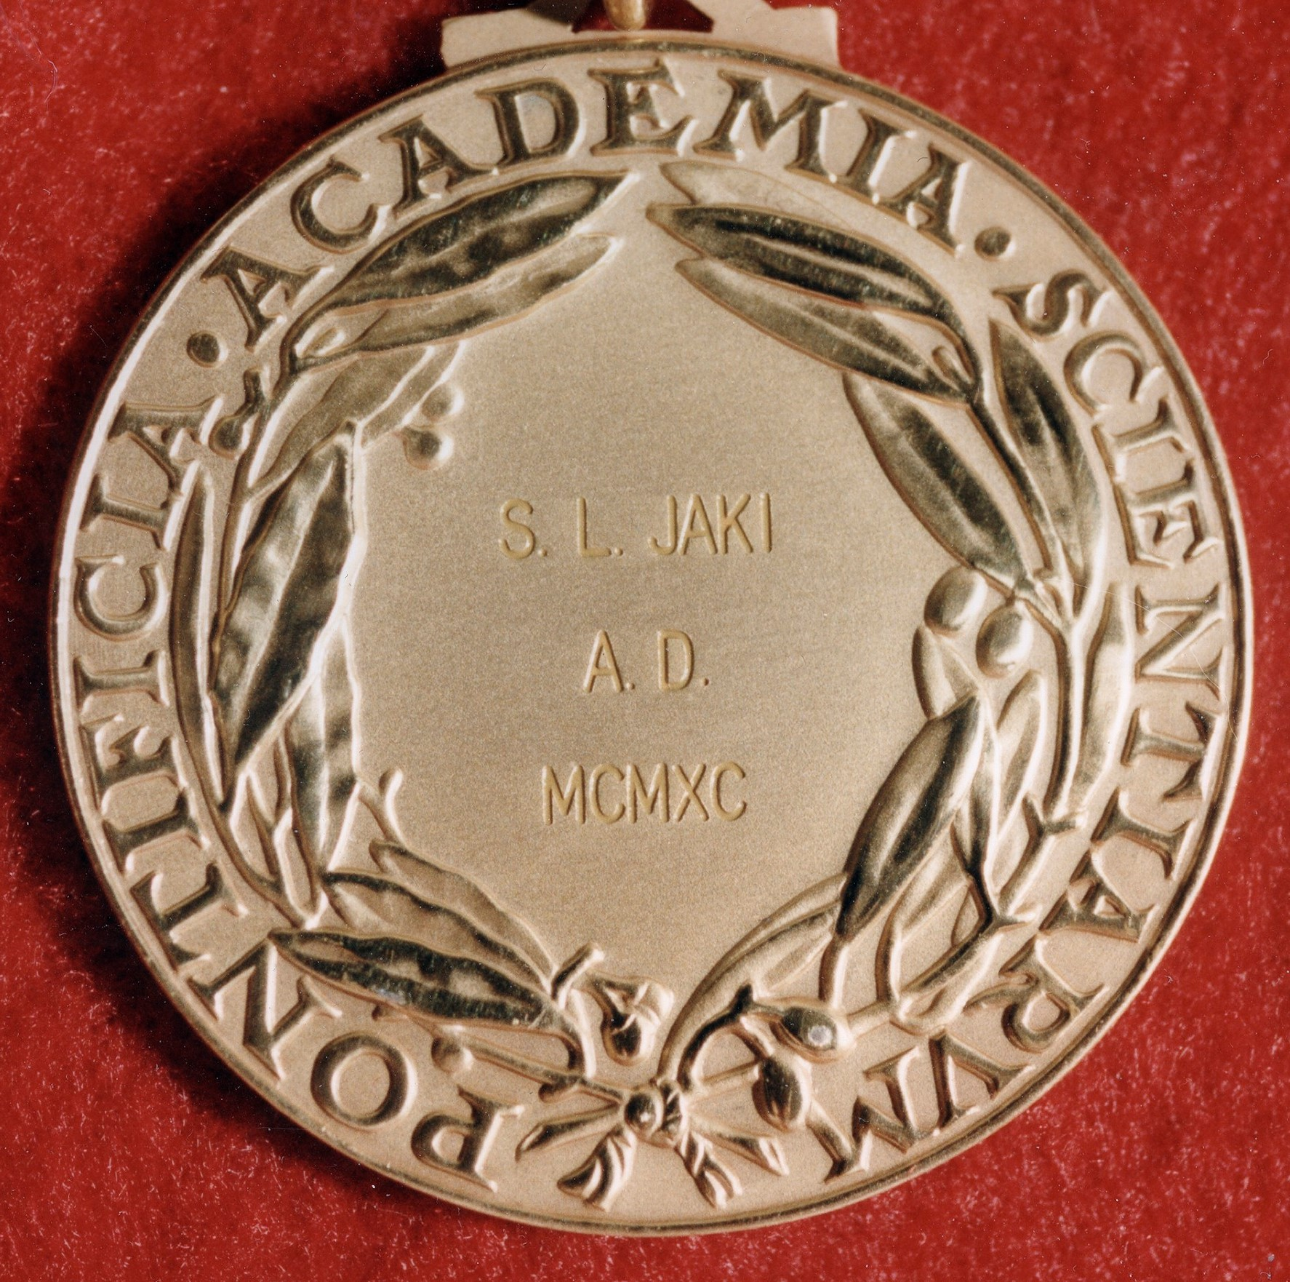
The Duke of Edinburgh right after he gave the Templeton Prize to Father Jaki – in the background Mr. and Mrs. John Templeton

Slide 22
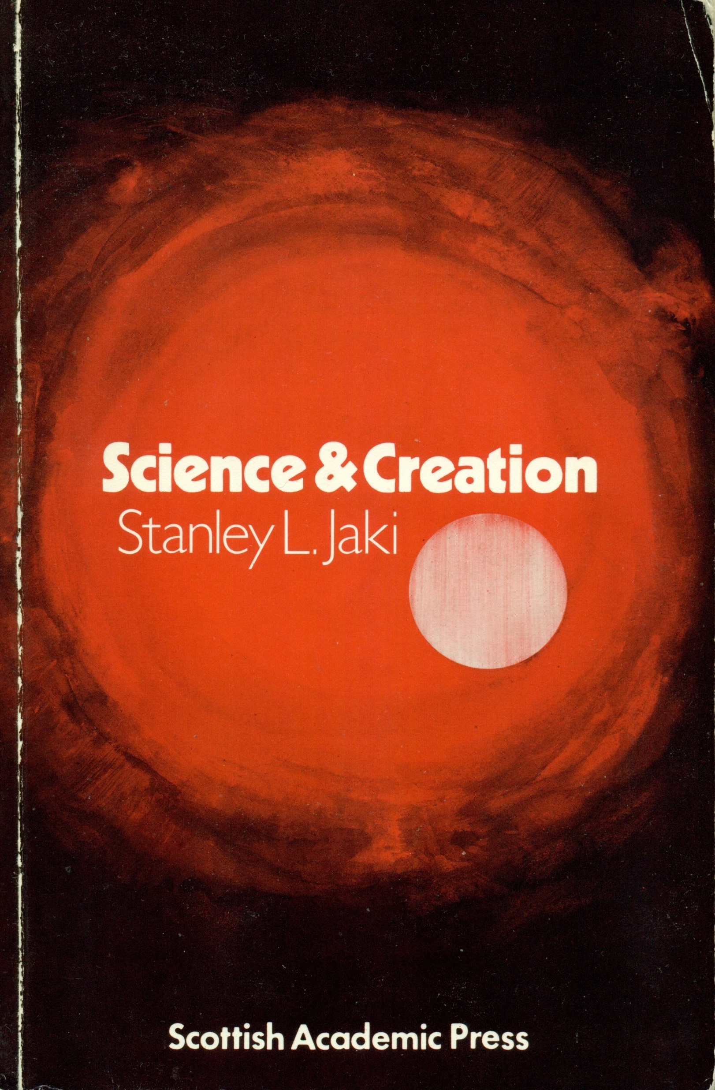
Science and Creation
Examines the reasons for the failed rise of science in all ancient civilization, and for its only birth in the (Christian) European civilization, starting in the Middle Ages.
A logical continuation of the work of Duhem

Slide 23
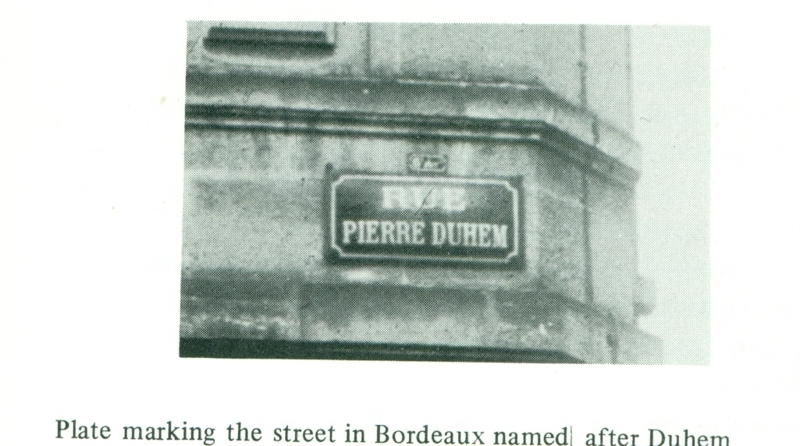
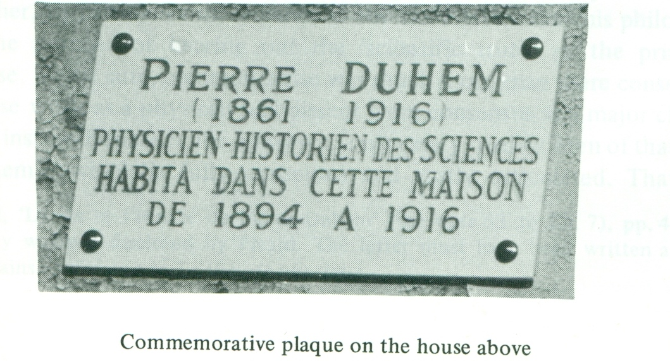
Jaki and Duhem
“For five or six years, or roughly from 1978-83, I literally lived most of my days with tangible ties to the memory of Pierre Duhem.”
-- Stanley Jaki, A Mind's Matter , p. 69
(the images below, taken by Stanley Jaki, are from Bordeaux)

Slide 24
Introduction to works of Duhem
1969 To Save the Phenomena
1985 Medieval Cosmology: Theories of Infinity, Place, Time, Void …
1987 Premices philosophiques
1988 The Physicist As Artist: The Landscapes of Pierre Duhem
1989 Au pays des Gorilles
1991 The Origins of Statics
1991 German Sciences
1994 Lettres de Pierre Duhem à sa fille Hélène
1995 (Chinese translation of) La Théorie Physique, son object - sa structure
Books
1984 Uneasy Genius: The Life and Work of Pierre Duhem
1991 Scientist and Catholic: Pierre Duhem (1991 in French, 1996 in Spanish)
1992 Reluctant Heroine: The Life and Work of Hélène Duhem (2007 in French)

Slide 25
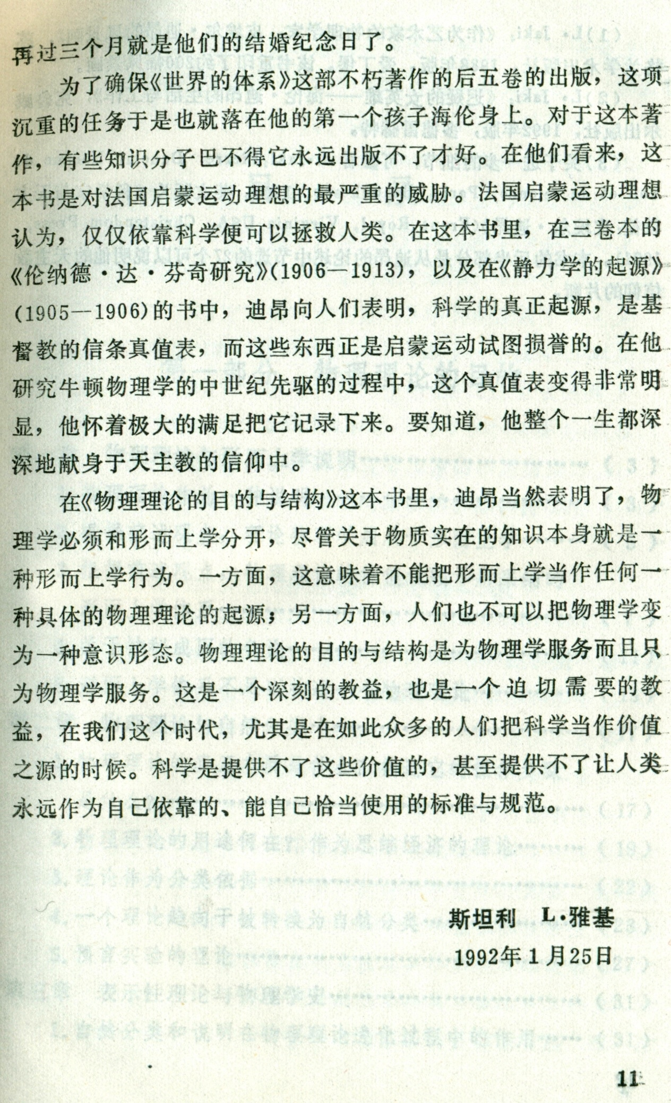
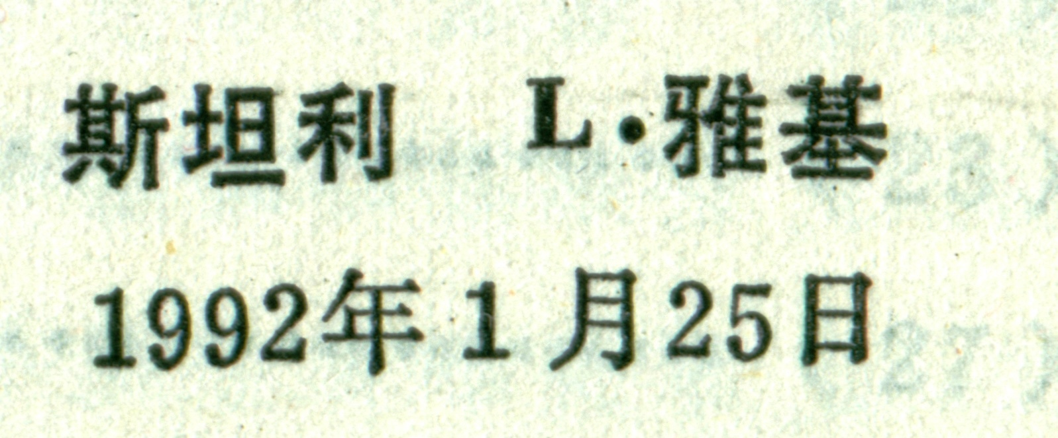
From the Introduction to the Chinese translation of Duhem’s
La Théorie physique: son objet - sa structure.
Stanley L. Jaki
25 January 1992

Slide 26
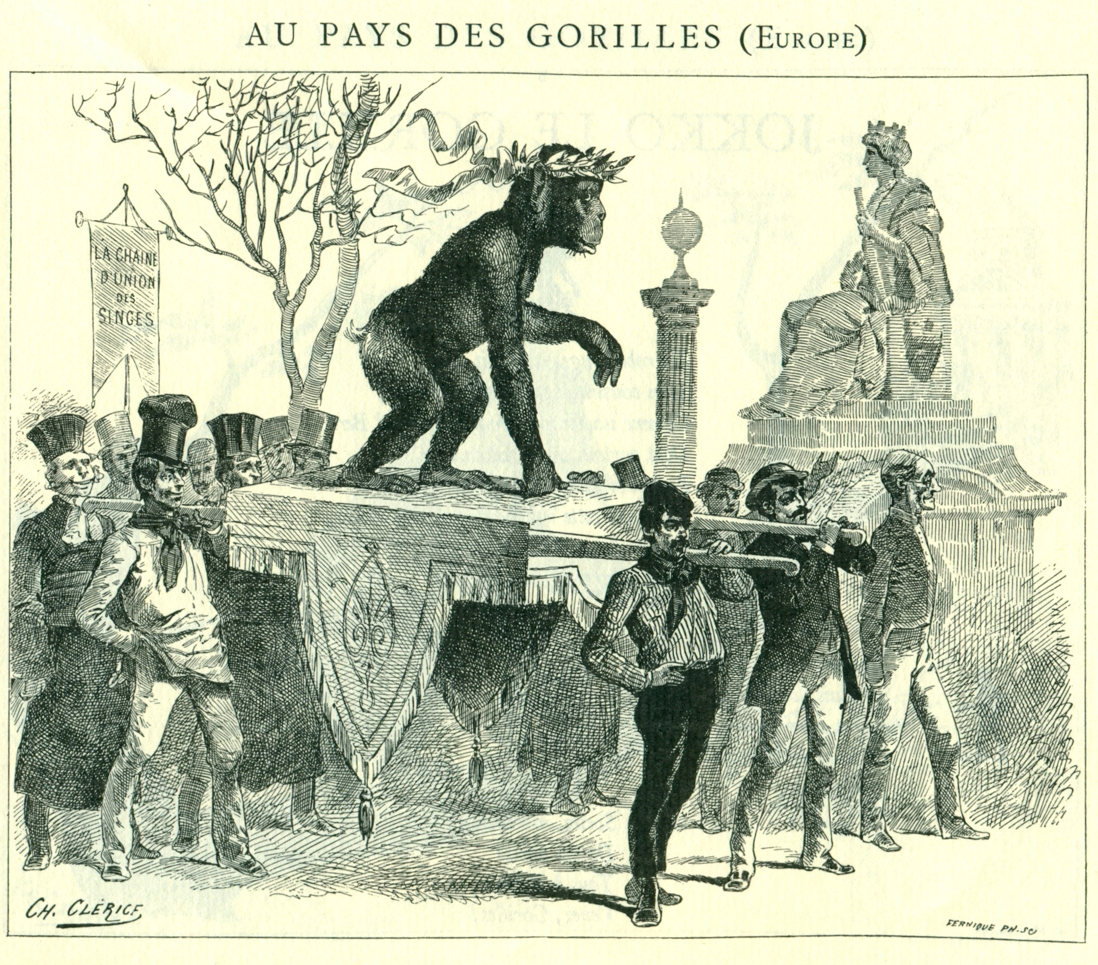

Slide 27
The Savior of Science
They (Muslims) say that the thing which exists with certain constant and permanent forms, dimensions, and properties, only follows the direction of habit, just as the king generally rides on horseback through the streets of the city, and is never found departing from this habit; but reason does not find it impossible that he should walk on foot through the place
-- Moses Maimonides, The Guide for the Perplexed

Slide 28
The Savior of Science
"If the Logos was fully divine, its creative work had to be the paragon of logic and order.”
-- Stanley Jaki, The Savior of Science, p. 83

Slide 29
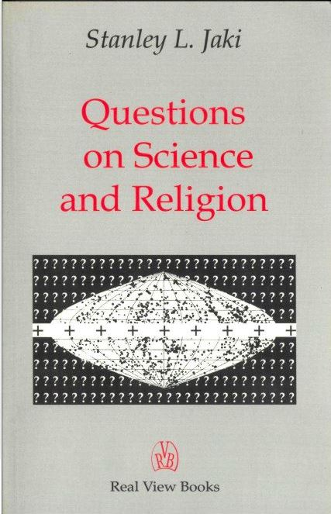
Questions on Science and Religion
is a book that outlines well Stanley Jaki positions
It can be found on amazon.com
or at:
http://www.realviewbooks.com
A site about Stanley Jaki:
http://www.sljaki.com

Slide 30
In memory of Pierre Duhem,
Illustrious professor of the University of Bordeaux,
Excelled by virtue no less than by learning,
Friend of the poor, model of the rich,
Wanted to assist rather than preside,
Loved truth more than friends,
Chastiser of errors, kind to those who err,
Had no enemies, except the enemies of truth,
Covered with merits, forgetful of himself,
Received renown, while fleeing honors,
Worthy of being crowned by Christ in heaven.

